Slide 1

West Midlands
Export Performance

Slide 2
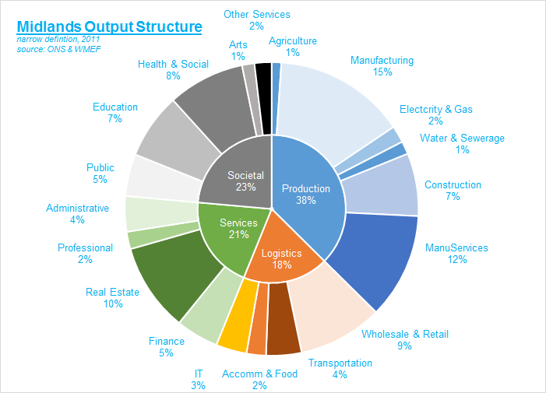

Slide 3
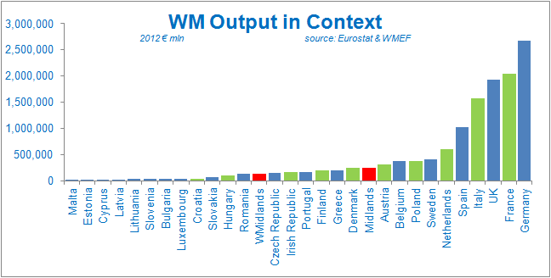


Slide 4
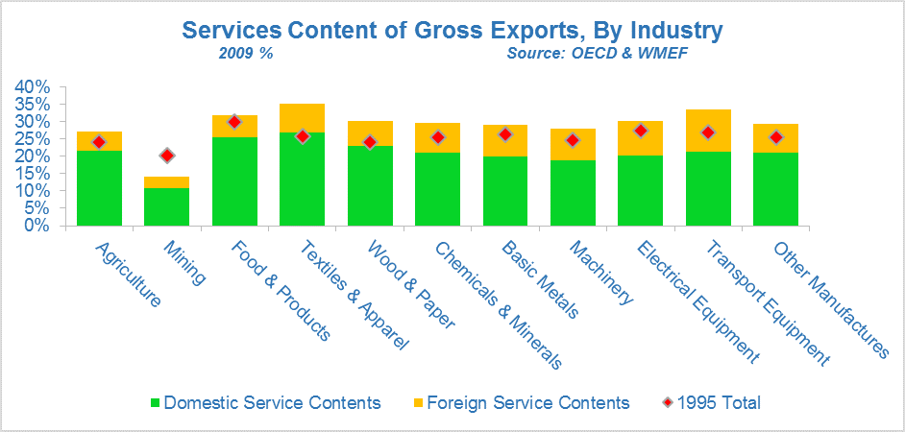

Slide 5
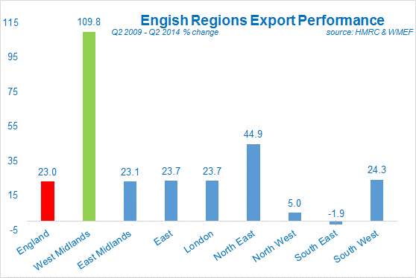


Slide 6
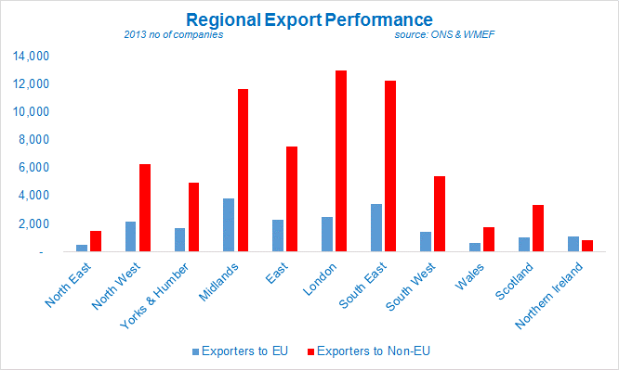

Slide 7
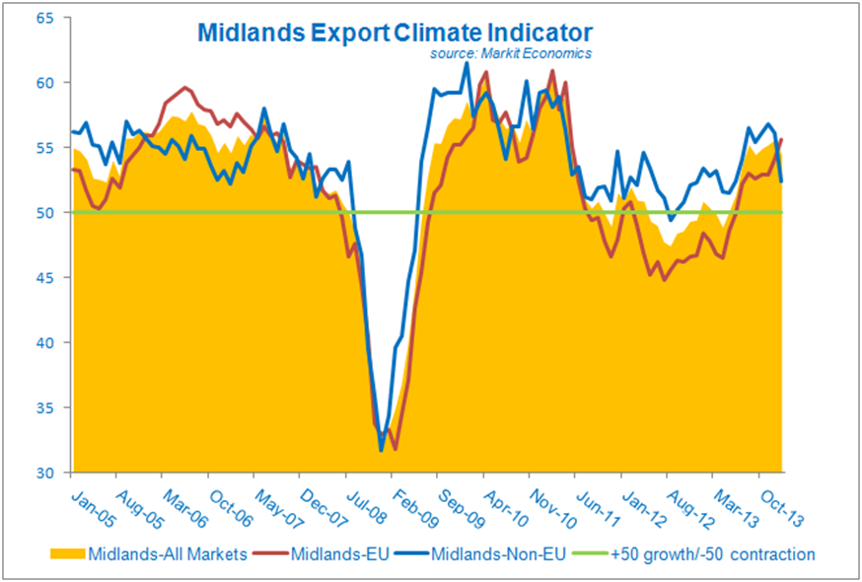

Slide 8
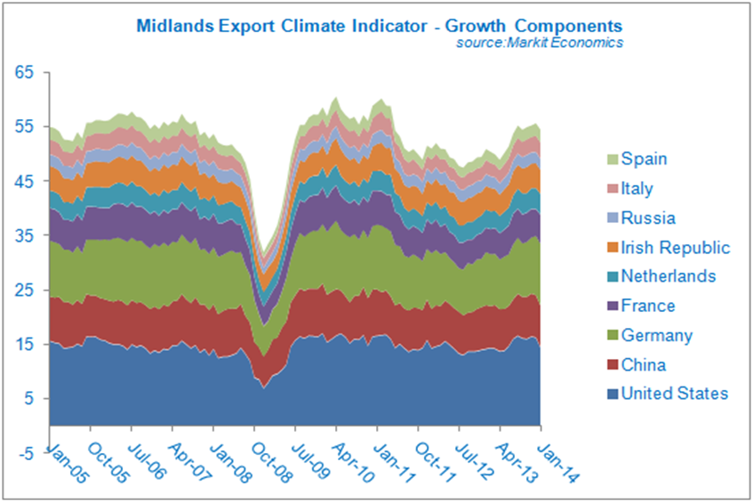

Slide 9
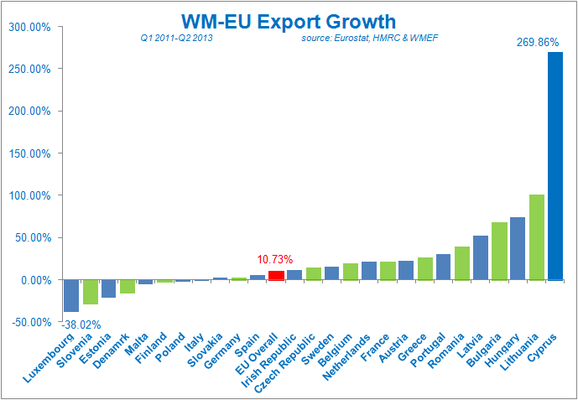

Slide 10
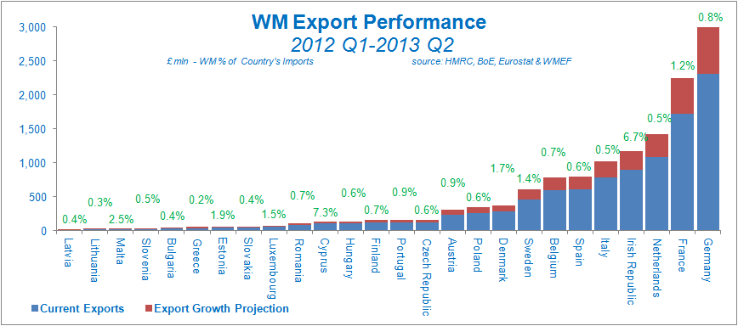

Slide 11
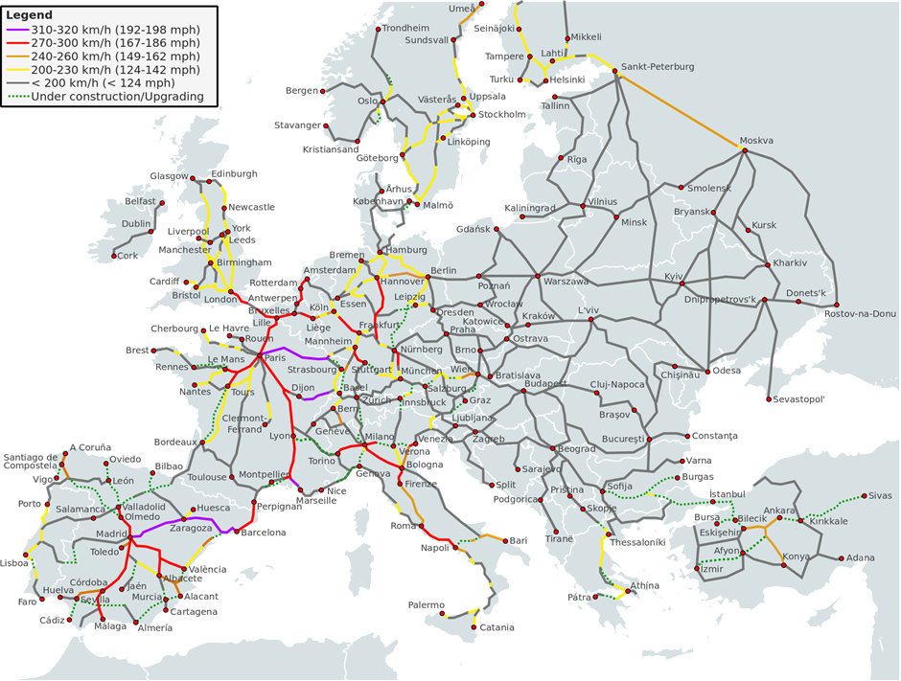

European Export-Import Infrastructure
Source: Wikipedia & WMEF

Slide 12
Birmingham
Amsterdam
0.45
1.28
2.39
2.40
3.18
5.16
1.53
2.55
1.51
4.52
Brussels
Koln
1.47
2.30
London
1.10
2.10
2.15
5.12
1.22
2.25
3.15
5.05
3.15
5.00
Frankfurt
3.48
6.13
Paris
1.50
3.55
Saarbrucken
2.20
4.00
1.51
4.52
Travel Times:
2009
1989
HS2
hours
Strasbourg
The Trans-European HSL – Operational Core
Source: EC & WMEF

Slide 13
Optimal Operating Distances
For journeys under 4.5 hours, the EC regard HSR as competitive with air travel
HSR Impacts – undermined commercial viability of Air Routes between:
Paris-Brussels Cologne-Frankfurt Madrid-Barcelona
Nanjing-Wuhan Chongqing-Chengdu Tokyo-Nagoya
Tokyo-Sendai Tokyo-Niigata London-?
Future Impacts:
Spain plans to ensure that 90 % of its inhabitants have access to an HSR station within 50 km of their home

Slide 15
